Slide 1
Interactive Game Theory Website
By Shreya Kumar

Slide 2
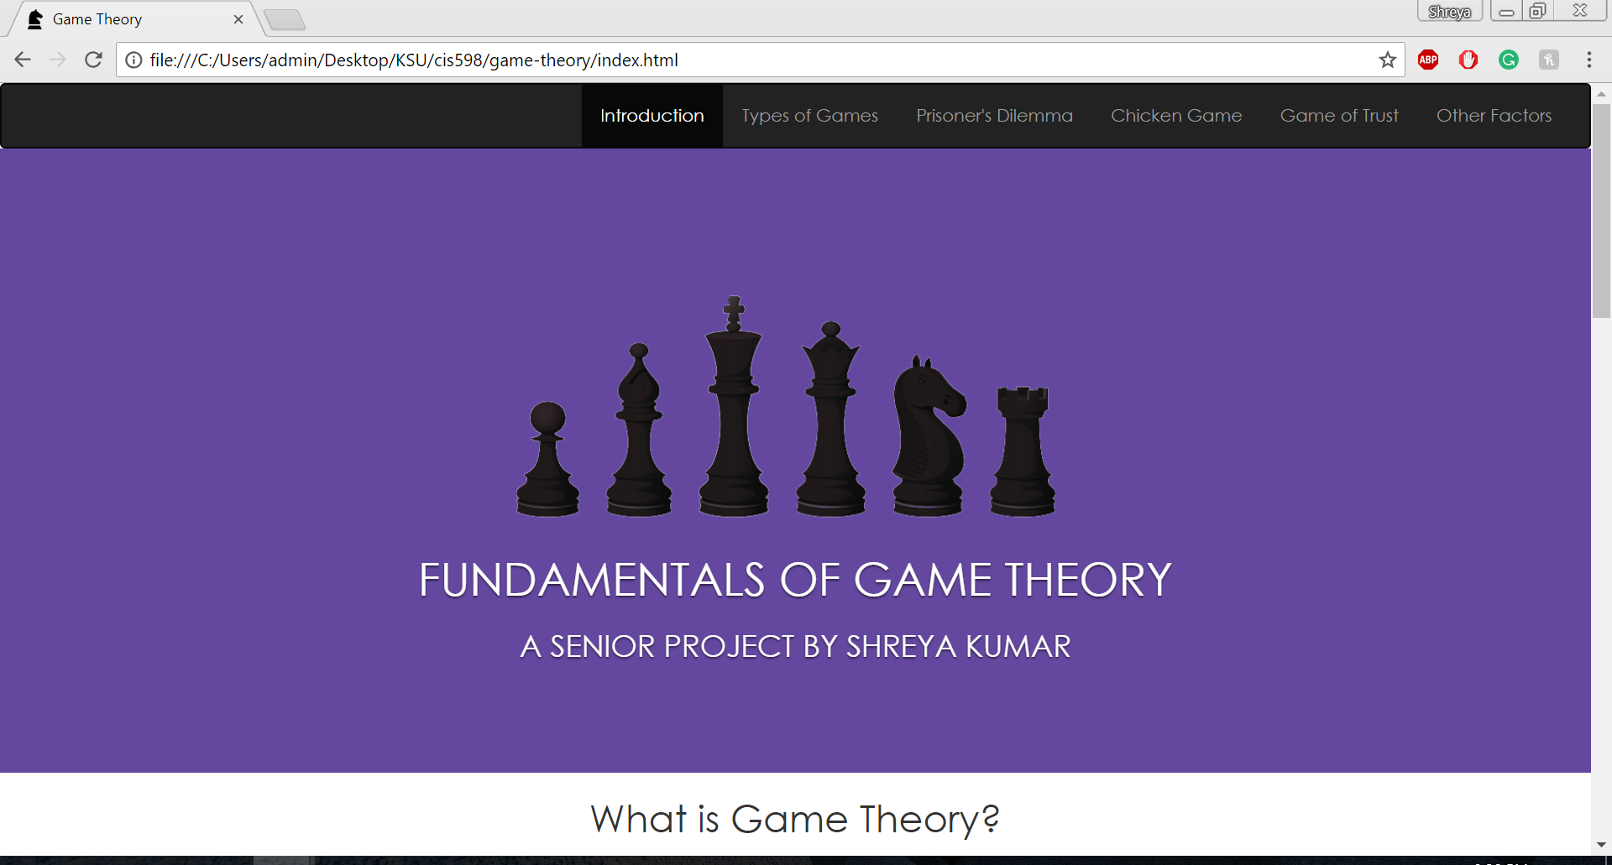
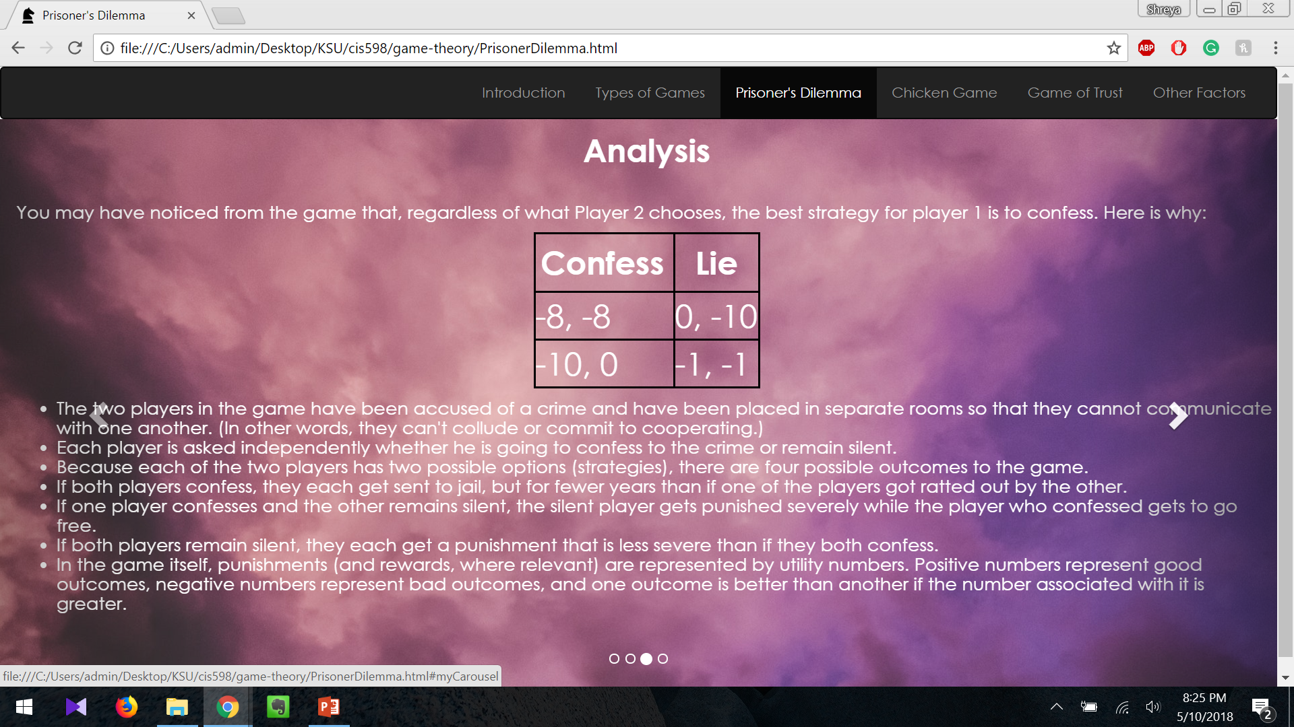
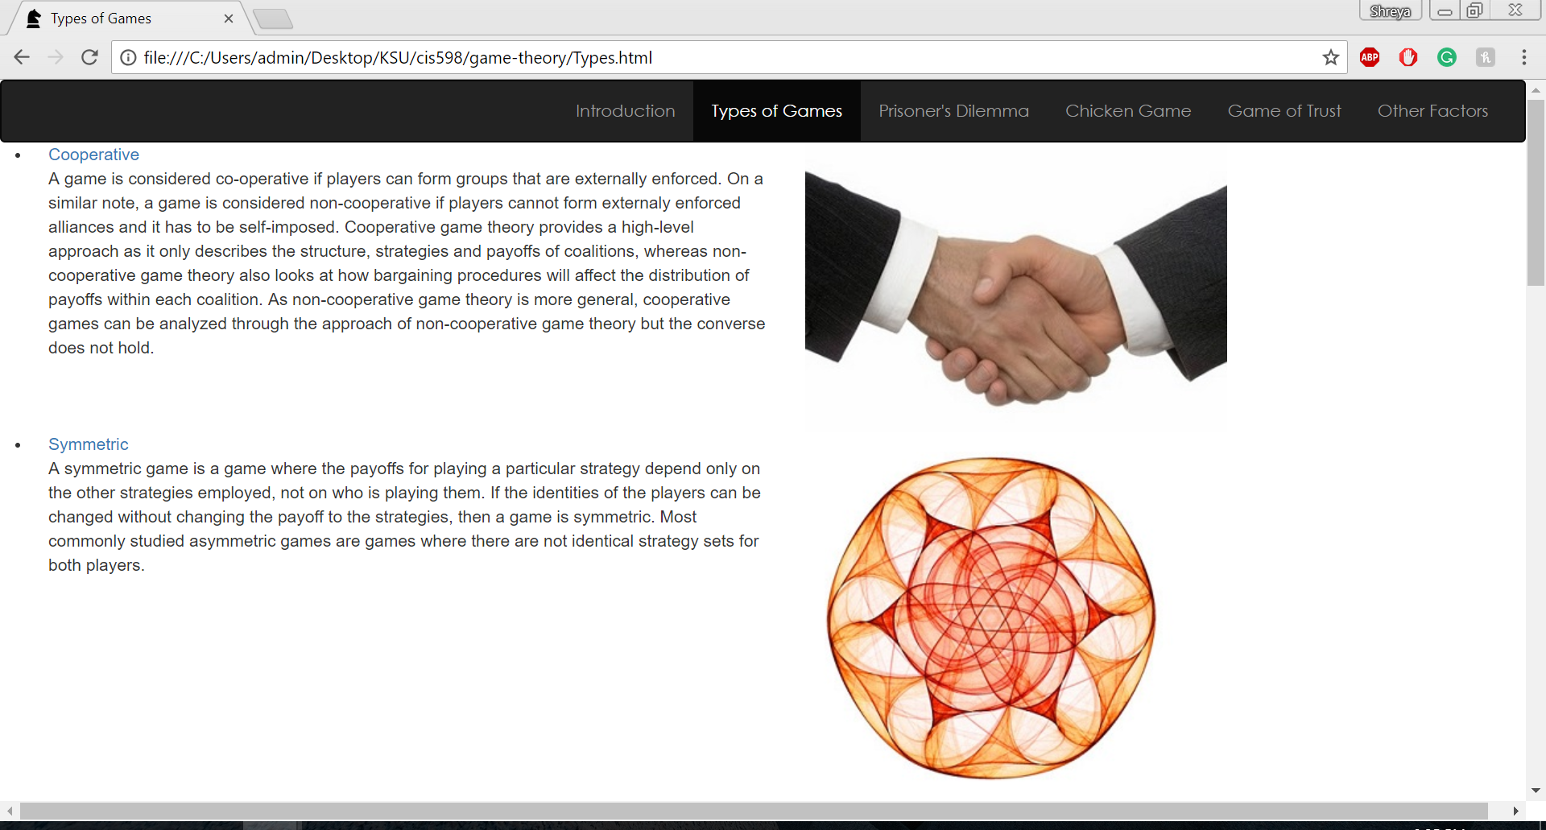
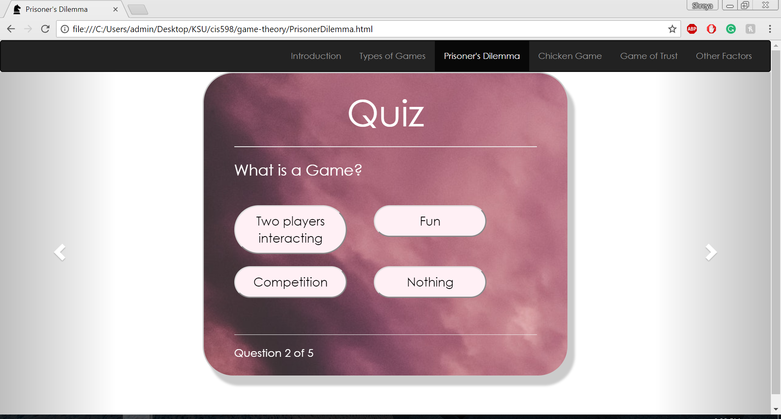
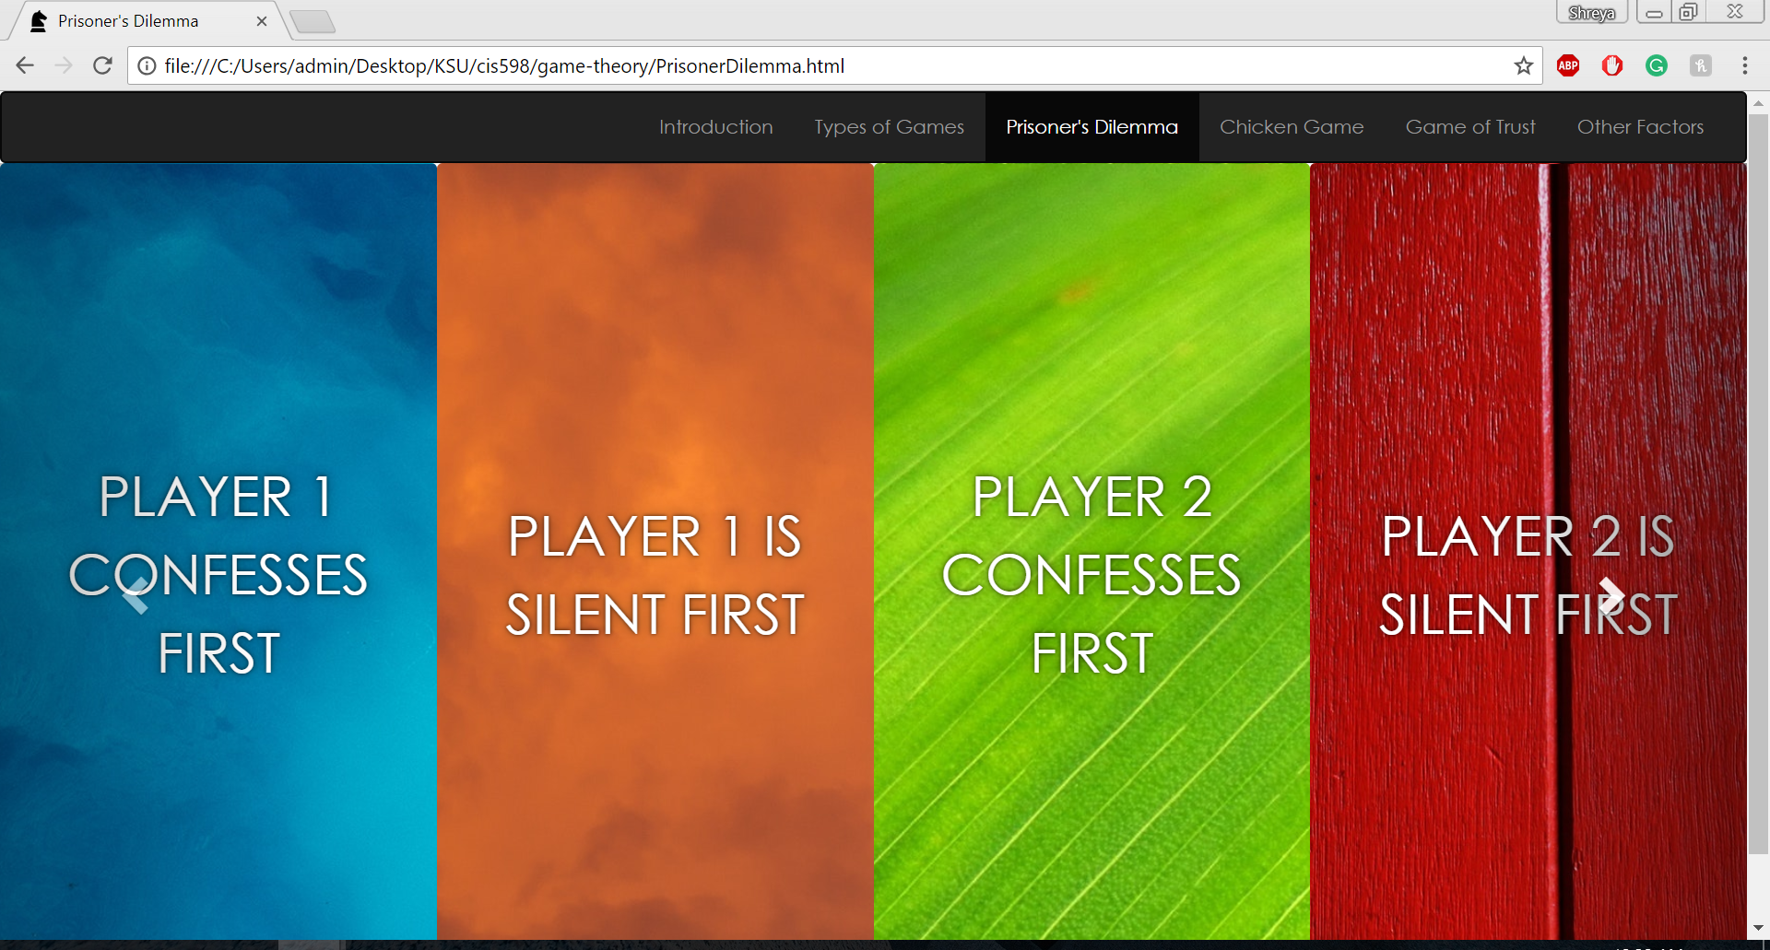
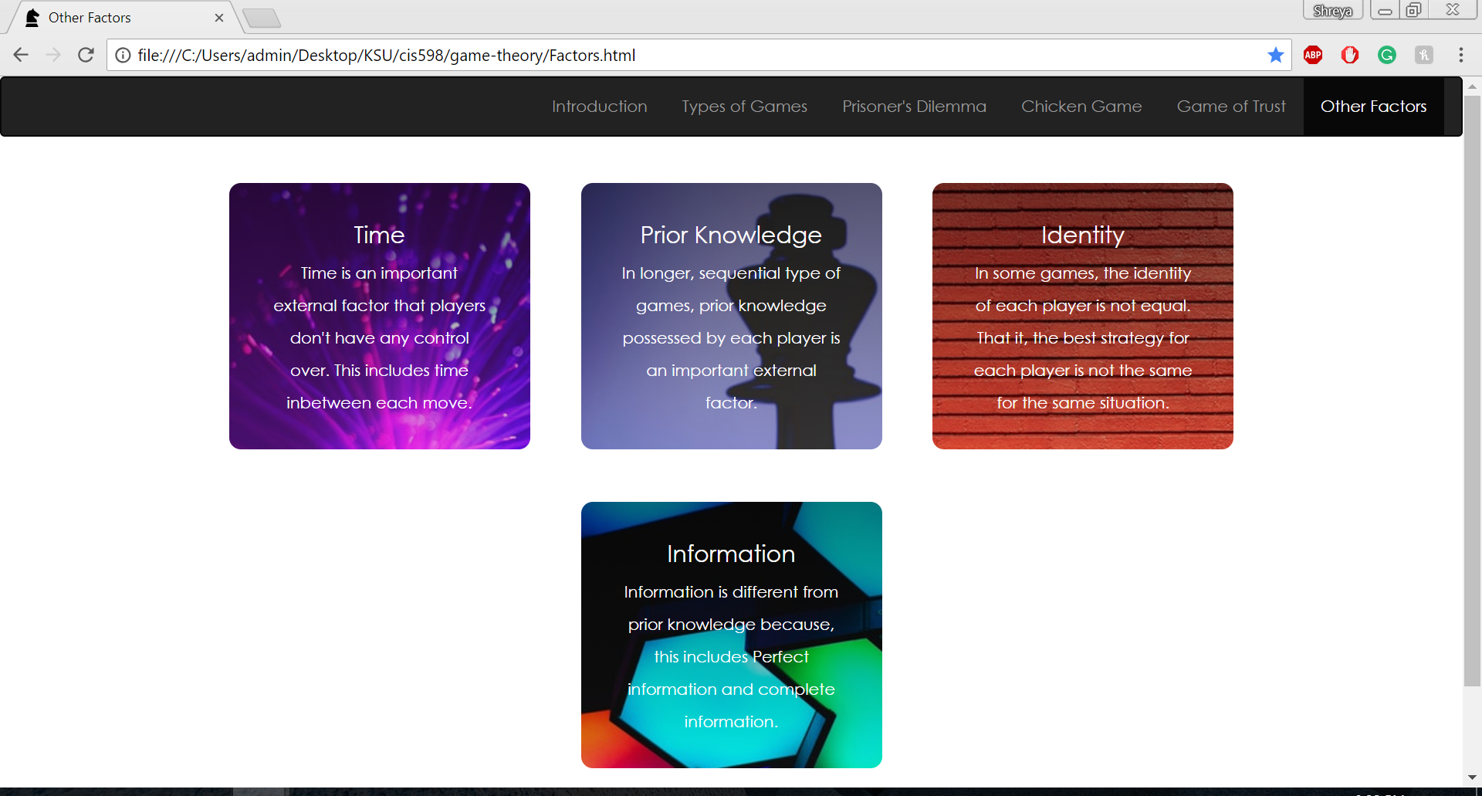
In this presentation:
Introduction
Analysis
Types of Games
Quiz
External Factors
Playing the Game

Slide 3
Features and Deliverables
Style Guide
1) Contains the UI elements, color scheme, fonts and other information used while developing the website
2) Includes desktop screenshots of all pages within the web app
Website
1) Made up of 6 pages
2) The introduction and types of games pages which are meant to be informational and give user some context
3) Three scenarios which have 4 subsections each that allow the user to interact with the games and learn more about the concepts behind it
4) External Factors page that talks about other factors outside the rules of the game and the strategy of the player that can affect the outcome

Slide 4
Home Page
Informational page that gives the user an intro to game theory and the basic terms within game theory
There is also a brief history of game theory described in the home page
Along with references to the content used in the page

Slide 5
Type of Games Page
Informational page that discusses different types of games in game theory
These types of games will be further explored when the user plays the scenarios and takes the quizzes
They will also be discussed in the external factors page

Slide 6
Scenarios – (Intro/Playing the Game)
There are three scenarios in the website Prisoner’s Dilemma, Chicken Game, Game of Trust
Each scenario has a brief introduction to give the player some context on the rules, then the player is given an option to pick one of the options
Then then the user gets a brief answer of what would happen when choosing that option

Slide 7
Scenarios (Analysis)
After deciding on their option and playing with the other options available
Users are taken to the analysis page
Where the complete analysis of that particular scenario is discussed
Including the matrix of each choice applicable to a player
Best case/worst case analysis
This is the third of four sections for each scenario

Slide 8
Scenarios (Quiz)
This is a quiz that can be taken by the user for each scenario
Comprises of 5-8 questions per scenario and the last slide tells the user how many they got right
The quiz is meant to be a final assessment of what the player has learnt for each scenario

Slide 9
External Factors
Talks about external concepts like time, identity of the player etc
That are outside of the rules of the game and the player’s strategy but effect the game
The page is made of responsive tiles that talk about each factor and type of game that each factor affects

Slide 10
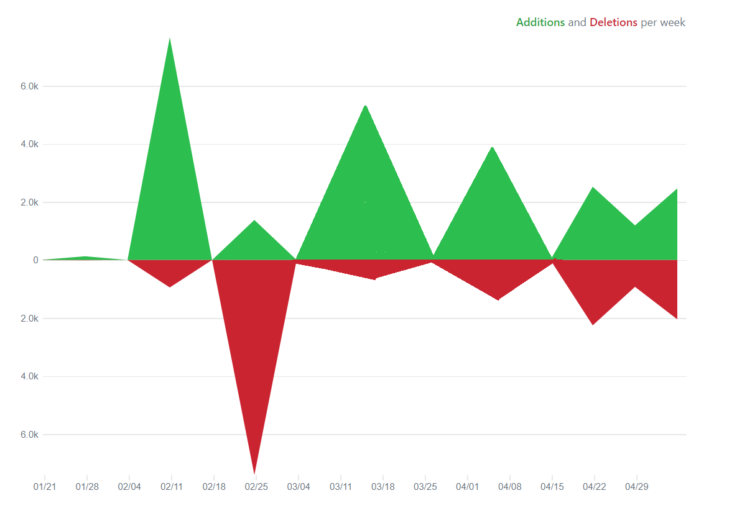
Code Per Week (1/27 – 5/11)

